Slide 1

Anthos Service Mesh

Slide 2

Sections
1 | What is Anthos Service Mesh
2 | What can we do with Anthos Service Mesh

Slide 3
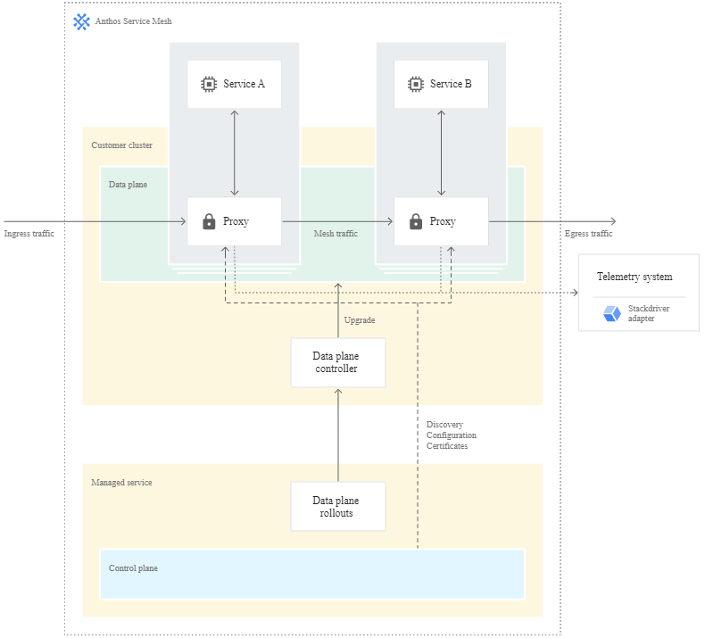
1
What is Anthos Service Mesh
A service mesh is an architecture that enables managed, observable, and secure communication across your services, letting you create robust enterprise applications made up of many microservices on your chosen infrastructure. Service meshes factor out all the common concerns of running a service such as monitoring, networking, and security, with consistent, powerful tools, making it easier for service developers and operators to focus on creating and managing great applications for their users.
Anthos Service Mesh is powered by Istio, a highly configurable and powerful open source service mesh platform, with tools and features that enable industry best practices. Anthos Service Mesh is deployed as a uniform layer across your entire infrastructure. Service developers and operators can use its rich feature set without making changes to application code.

Slide 4
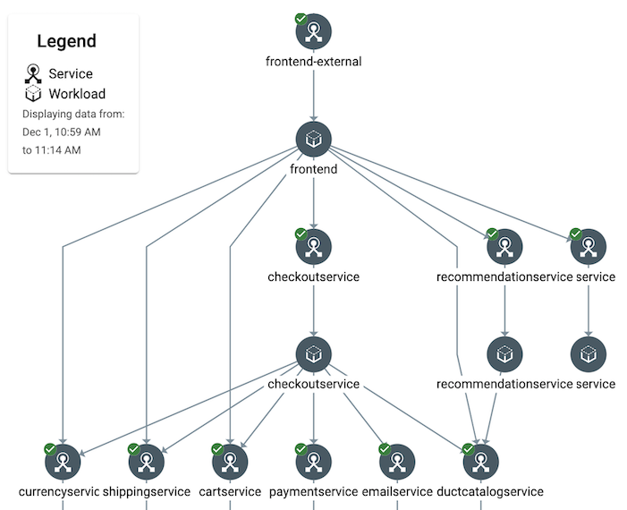
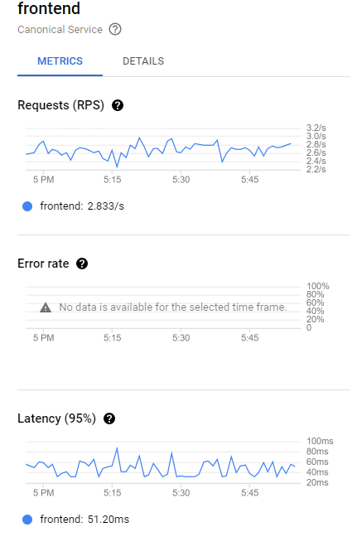
2
What can we do with Anthos Service Mesh
Better monitoring and SLOs
Anthos Service Mesh provides observability into the health and performance of your services. With this system, service developers don't have to instrument their code to collect telemetry data. On the Anthos Service Mesh pages in the Google Cloud console, you can:
Get an overview of all services in your mesh, providing you critical, service-level metrics on three of the four golden signals of monitoring: latency, traffic, and errors.
Define, review, and set alerts against service level objectives (SLOs), which summarize your service's user-visible performance.
View metric charts for individual services and deeply analyze them with filtering and breakdowns, including by response code, protocol, destination pod, traffic source, and more.
Get detailed information about the endpoints for each service, and see how traffic is flowing between services, and what performance looks like for each communication edge.
Explore a service topology graph visualization that shows your mesh's services and their relationships.

Slide 5
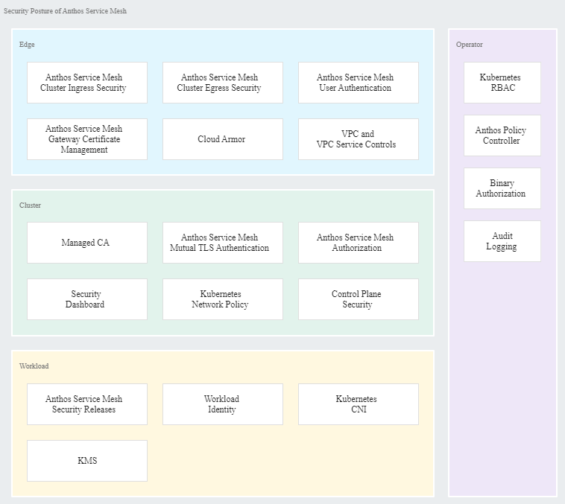
2
What can we do with Anthos Service Mesh
Security with policies, encryption and authentication
The security of a service mesh depends on the security of the components at different layers of the mesh system and its applications. The high-level intention of the proposed Anthos Service Mesh security posture is to secure a service mesh through integrating multiple security mechanisms at different layers, which jointly achieve the overall system security under the zero-trust security model. The right diagram shows the proposed Anthos Service Mesh security posture.

Slide 6
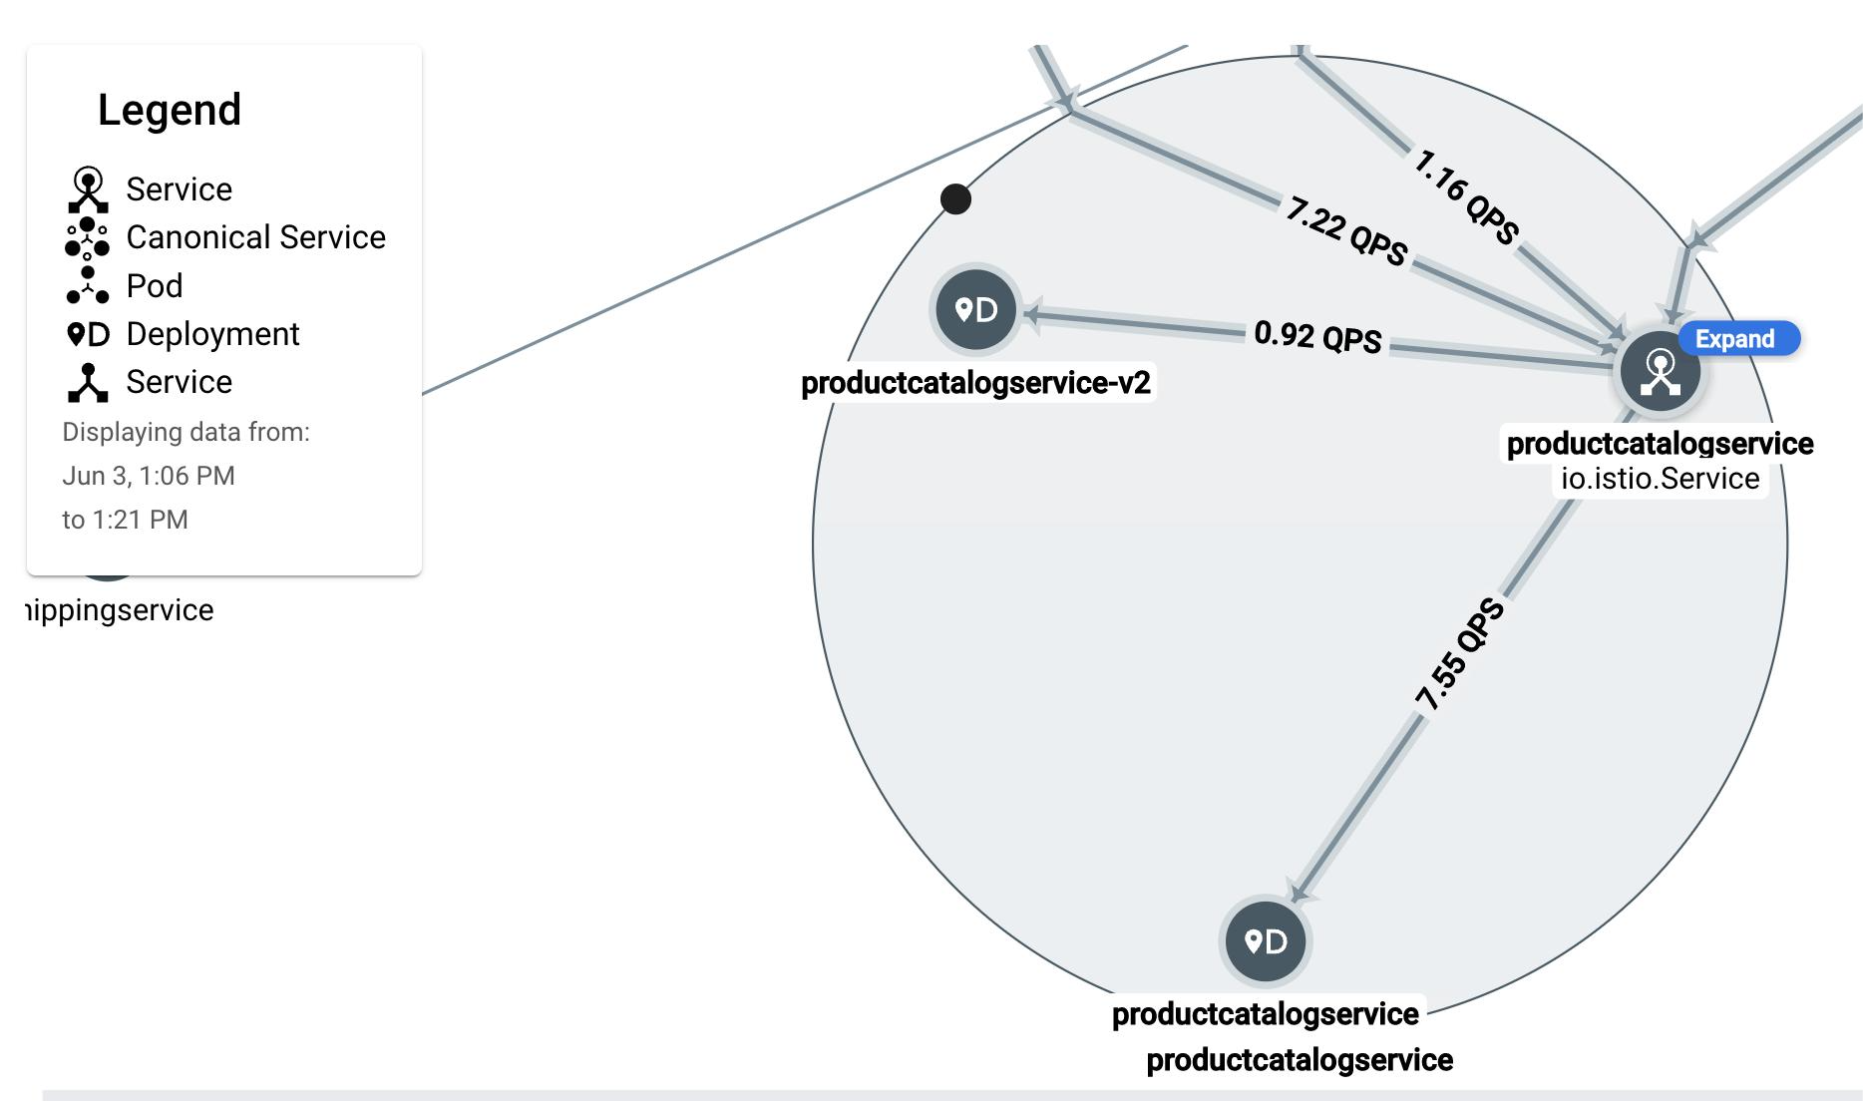
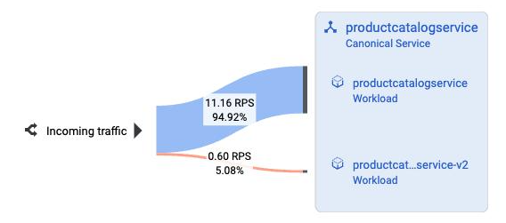
2
What can we do with Anthos Service Mesh
Traffic management
Anthos Service Mesh controls the flow of traffic between services, into the mesh (ingress), and to outside services (egress). You configure and deploy Istio-compatible custom resources to manage this traffic at the application (L7) layer. For example, with the custom resources, you can:
Create canary and blue-green deployments.
Provide fine-grained control over specific routes for services.
Configure load balancing between services.
Set up circuit breakers.

